Slide 1
Modern Data Engineering in the Cloud
PART 1 : FOUNDATIONS IN DATA ENGINEERING

Slide 2
Introduction and Motivation
Introductory words
What is Data Engineering?
Motivation and Value Proposition - a historic overview
How does Data Engineering look like in many companies?
What are features and advantages of workflow-based ETL?
Motivation for the use of ETL tools.
Data Engineering and Business Process Automation - similarities and differences

Slide 3
Learning Goals
-After the 5 days you are able to engineer automatic batch based and realtime Data-Pipelines with PDI and KAFKA
-You have hands-on experience with 2 most used techniques in DE
-You have an overview and foundation of the huge field of Data Engineering namly on the processual part (storage is also a topic of Data Lab 1 and 2)
-You have the possibility to dive into the topic if you use it. You got information there.

Slide 4
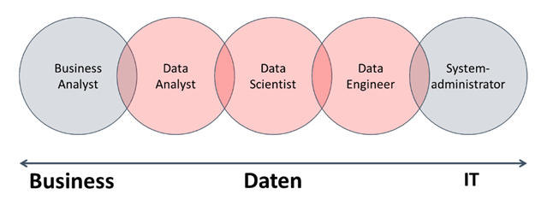
Introduction and Motivation: Roles

Slide 5
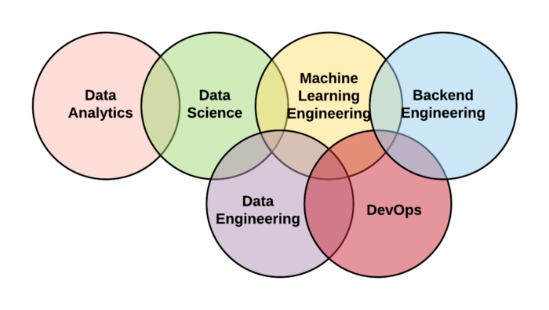
Introduction and Motivation: Areas

Slide 6
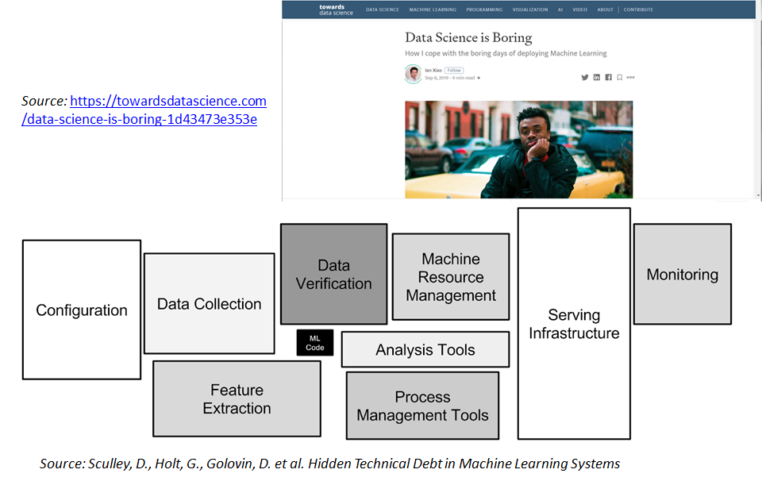

Slide 7
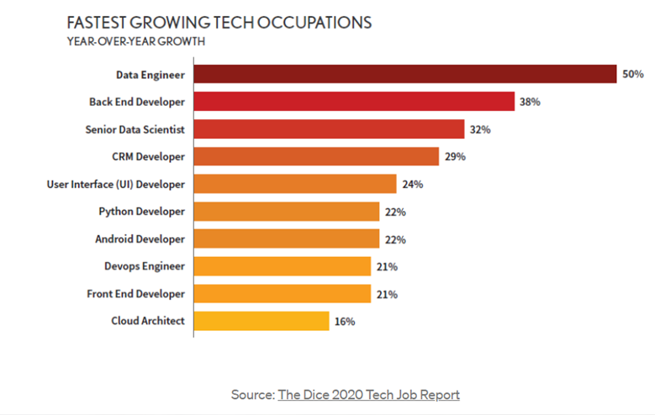
Introduction and Motivation

Slide 8
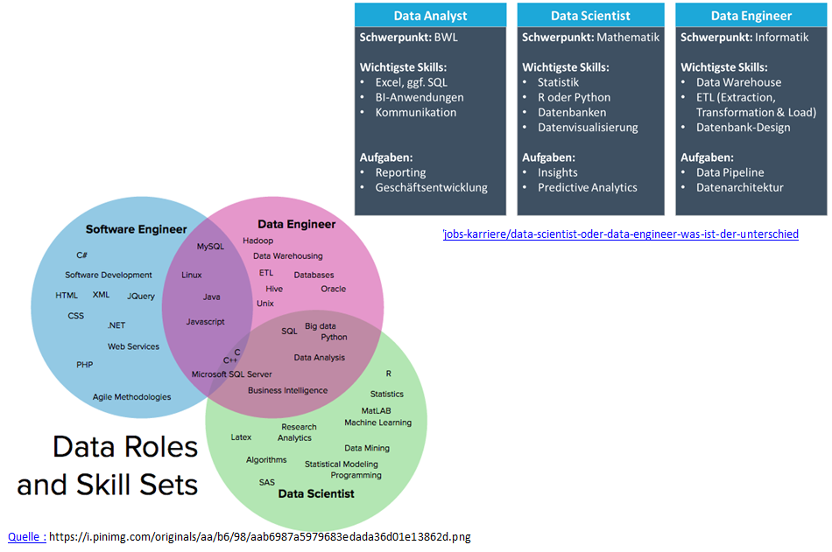
Introduction and Motivation
Notes:
Grob gesprochen ist der Data Engineer für die Infrastruktur der Daten zuständig. Insbesondere geht es um die saubere und verlässlichen Aufbau der Datenströme. Man spricht dabei von sogenannten data pipelines.
Das ist vor allem bei Big Data alles andere als trivial. Daher ist die Berufsbezeichnung Data Engineer eng mit Big Data verknüpft. Hat man “nur” normale Datenbanken, würde man vermutlich eher vom BI-Developer oder Data Warehouse-Specialist sprechen.
Der Data Engineer sollte sich also mit den modernen Tools für Big Data auskennen, sprich Hadoop, Hive, Spark, NoSQL-Datenbanken etc. Er sorgt im Endeffekt dafür, dass eine Big Data-Infrastruktur vorhanden ist, auf der ein Data Scientist dann die Analytics, z.B. maschinelles Lernen, durchführen kann.

Slide 9
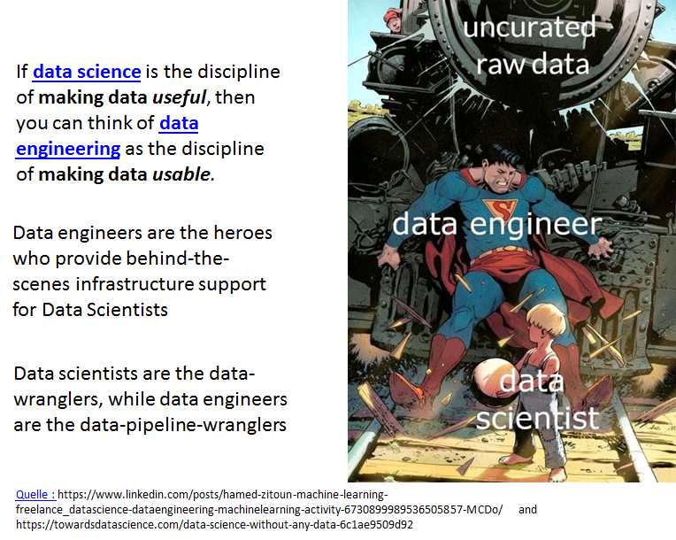
Introduction and Motivation

Slide 10
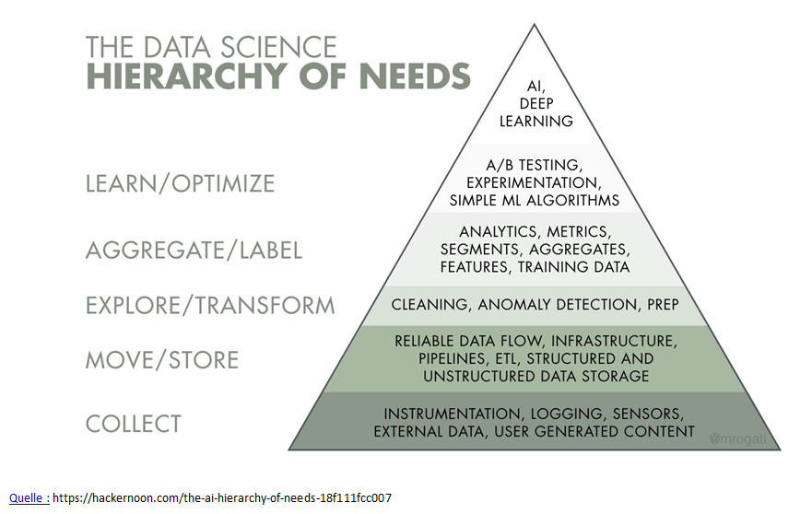

Slide 11
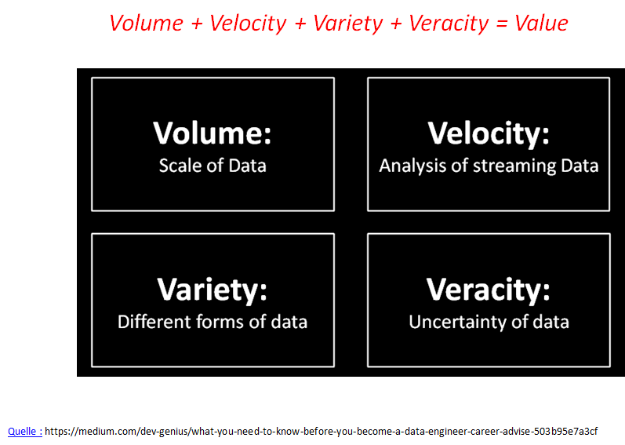
Introduction and Motivation
Notes:
Volume means that the data is big in size, which is obvious, because when we think of big data, we have in mind something that is really big.
Velocity means speed in a particular direction, in the context of big data it means that the data (in addition to being big in size) is travelling in a fast speed and we have to make analysis of that real time data which is traveling fast from one end point to another such as fast trading data or data from airplane sensors to make real-time quick decisions based on the data input.
Variety means that data is available in multiple formats, such as structure, unstructured, JSON format or XML format, Table structure or Key-Value Pair. Because data can be coming from multiple devices and from multiple sensors (in case of IoT, for example).
Veracity means whether the data is correct or not. Not all data is correct or trustworthy. It refers to the noise, biases and abnormality of data. We have to try to keep inaccurate data out of the system to have accurate and unbias analysis of those data.

Slide 12
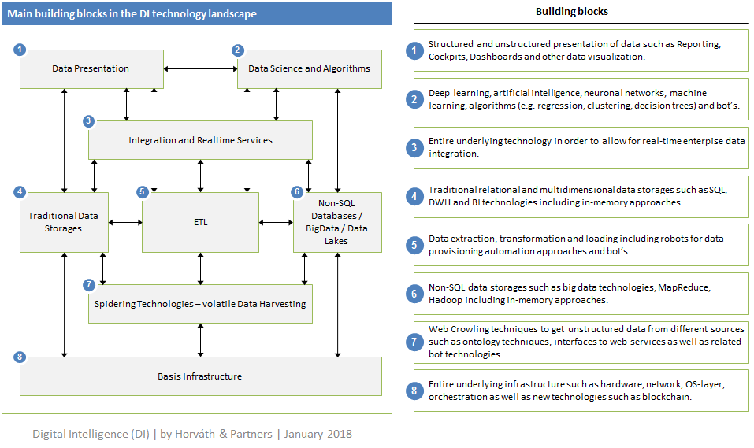
Introduction and Motivation
Notes:
Zusammenstellung der Buzzwords und deren Bedeutung sowie Zusammenspiel derselben

Slide 13
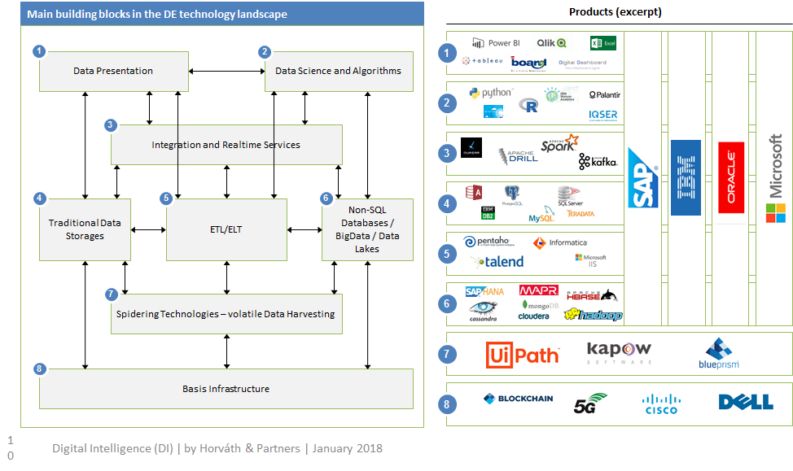
Introduction and Motivation
Notes:
Einige Produkte, welche in den BEreichen eingesetzt werden

Slide 14
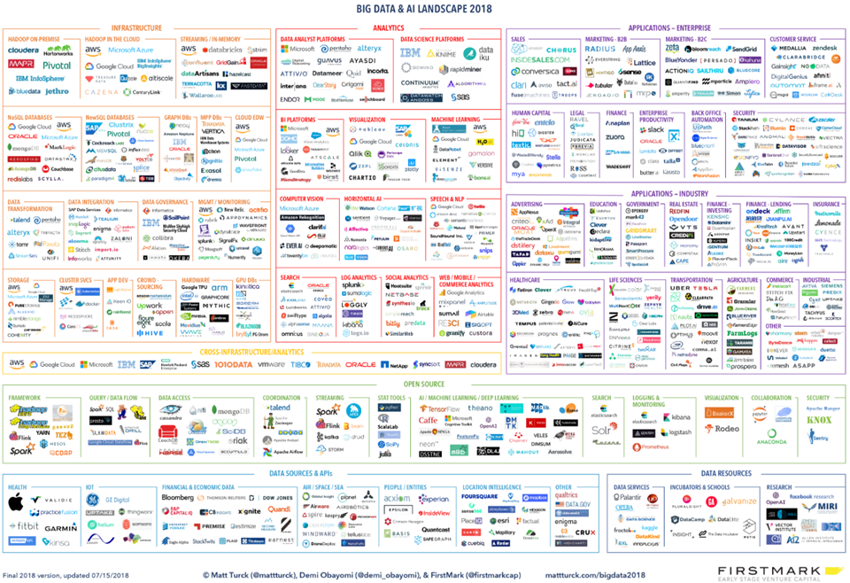
Introduction and Motivation
Notes:
Übersicht über alle Tool-Hersteller und Produkte/Brands im Umfeld von Data Engineering

Slide 15
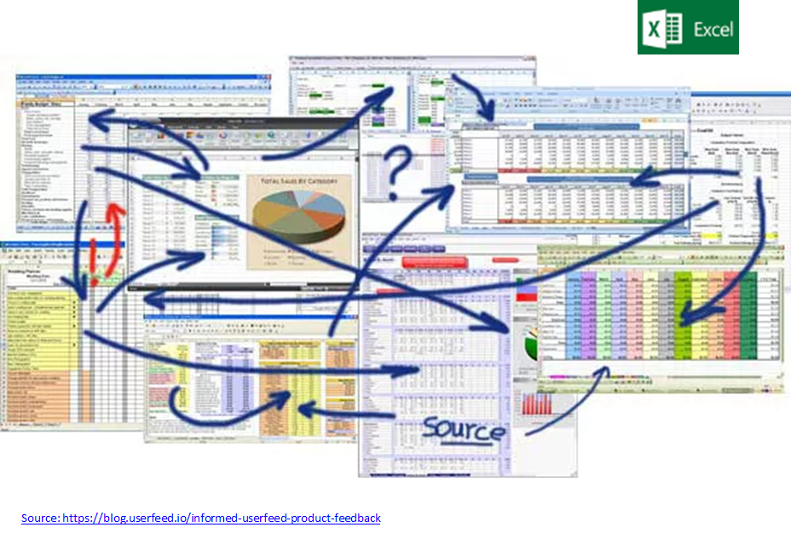
Introduction and Motivation: How does Data Engineering look like in many companies ?

Slide 16
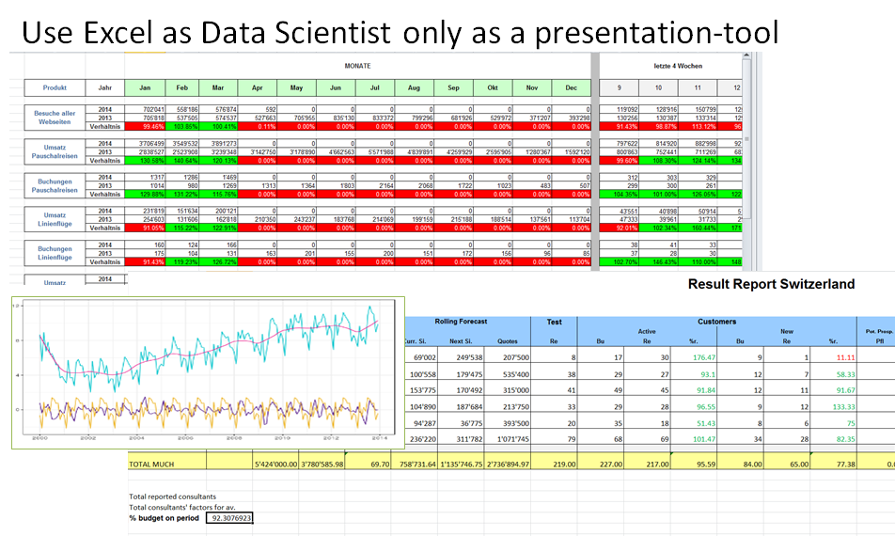
Introduction and Motivation: How does Data Engineering look like in many companies ?

Slide 17
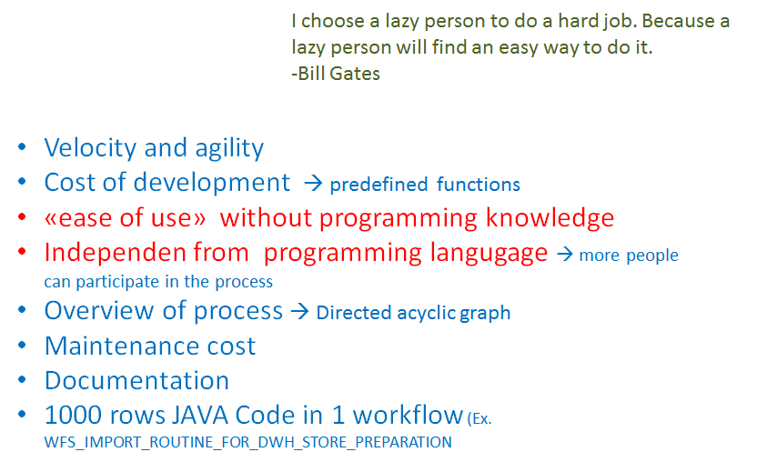
Introduction and Motivation: Motivation for the use of ETL tools. Data Engineering and Business Process Automation - similarities/differences

Slide 18
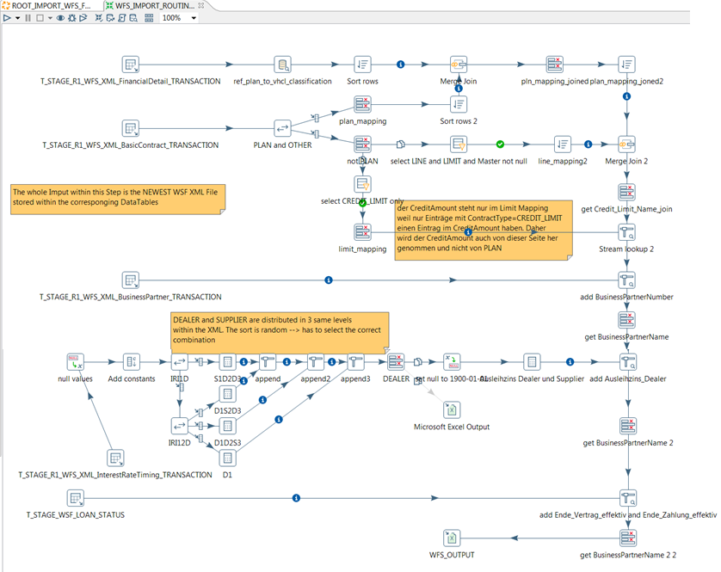
Introduction and Motivation:
Notes:
Wie man ca. 2’500 JAVA Zeilen JAVA Code in einen übersichtlichen Data-Stream verwandelt

Slide 19
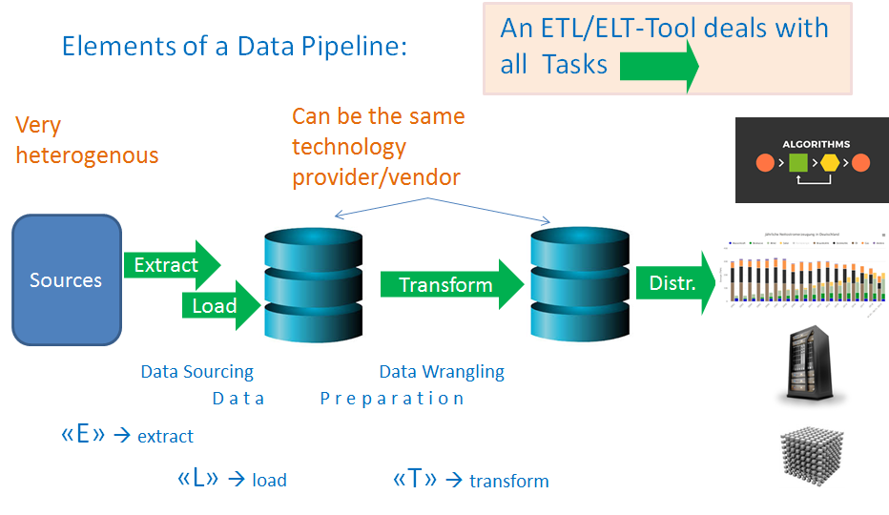
Introduction and Motivation

Slide 20
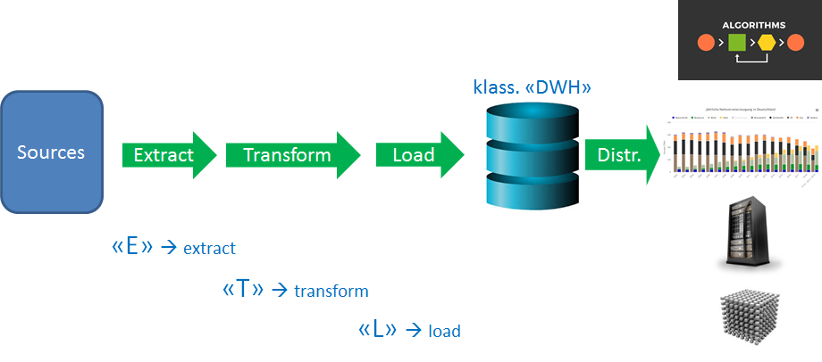
Introduction and Motivation

Slide 21
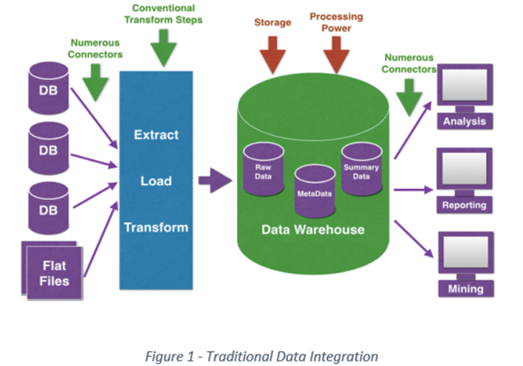
Introduction and Motivation
Notes:
traditionelle Betrachtungsweise klassischer BI-Architekturen

Slide 22
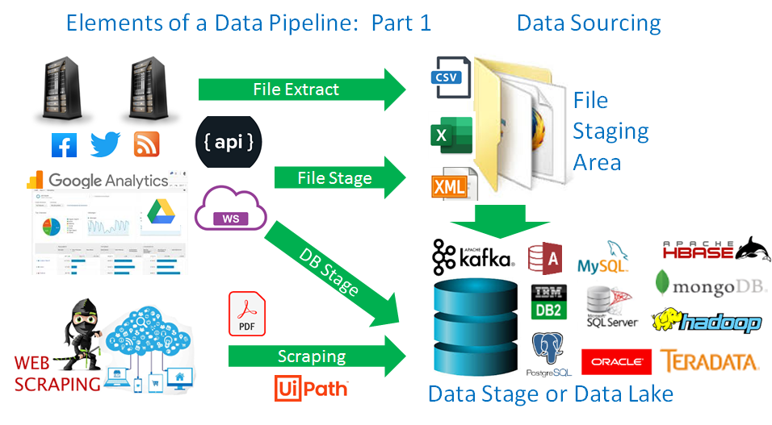
Introduction and Motivation

Slide 23
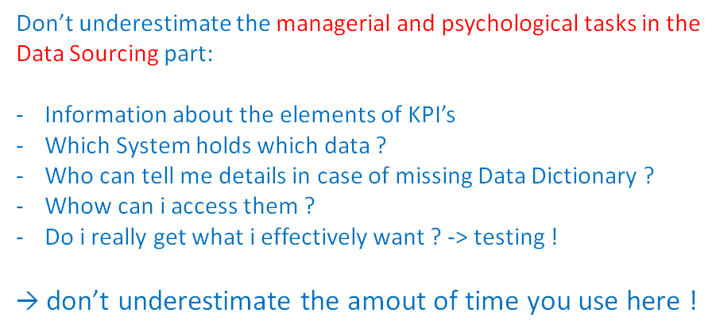
Introduction and Motivation

Slide 24
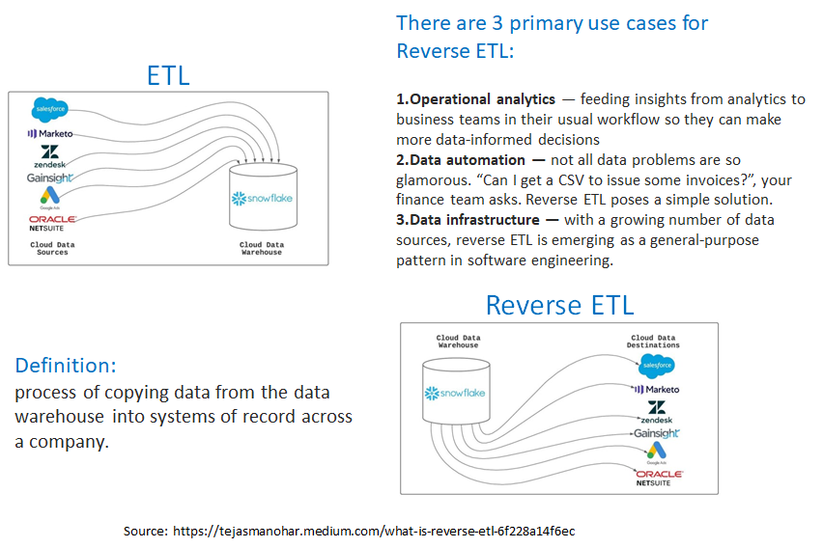
Introduction and Motivation

Slide 25
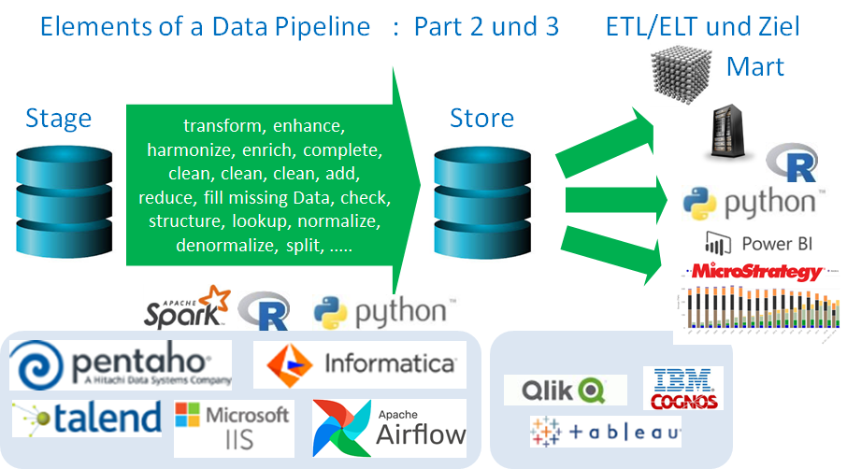
Introduction and Motivation

Slide 26
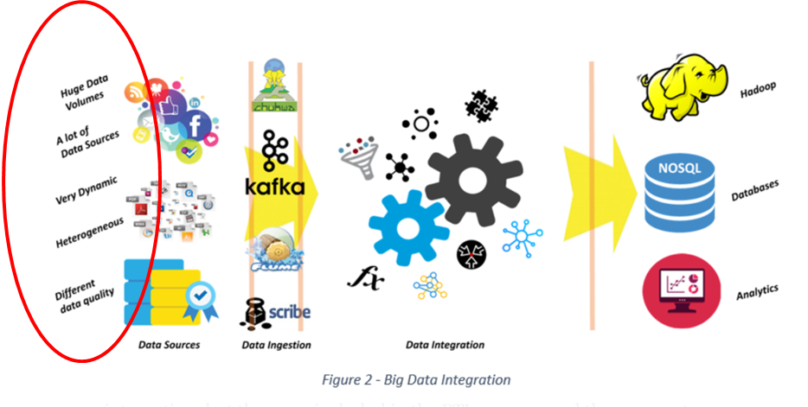
Introduction and Motivation

Slide 27
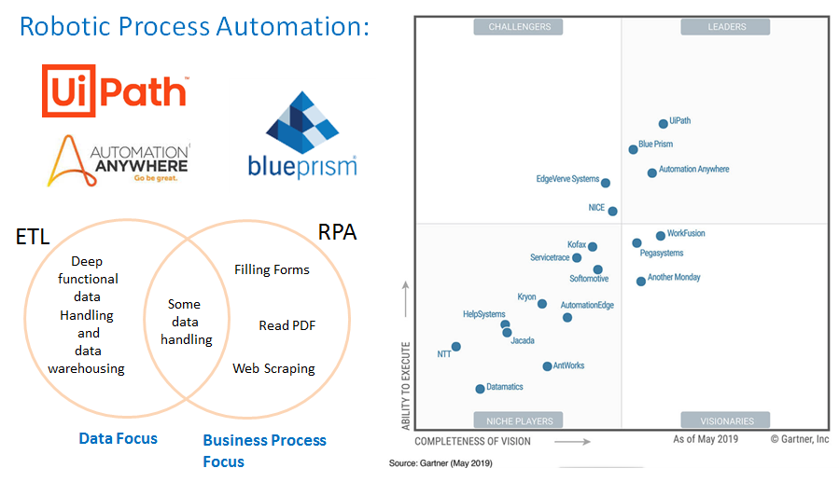
Introduction and Motivation

Slide 28
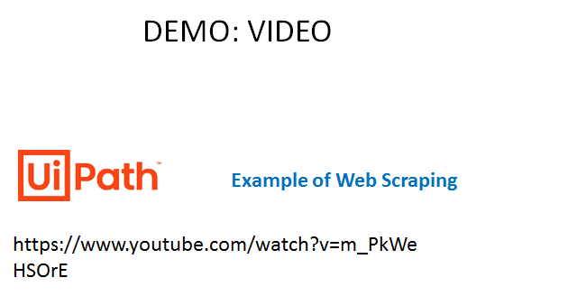
Introduction and Motivation

